Slide 1

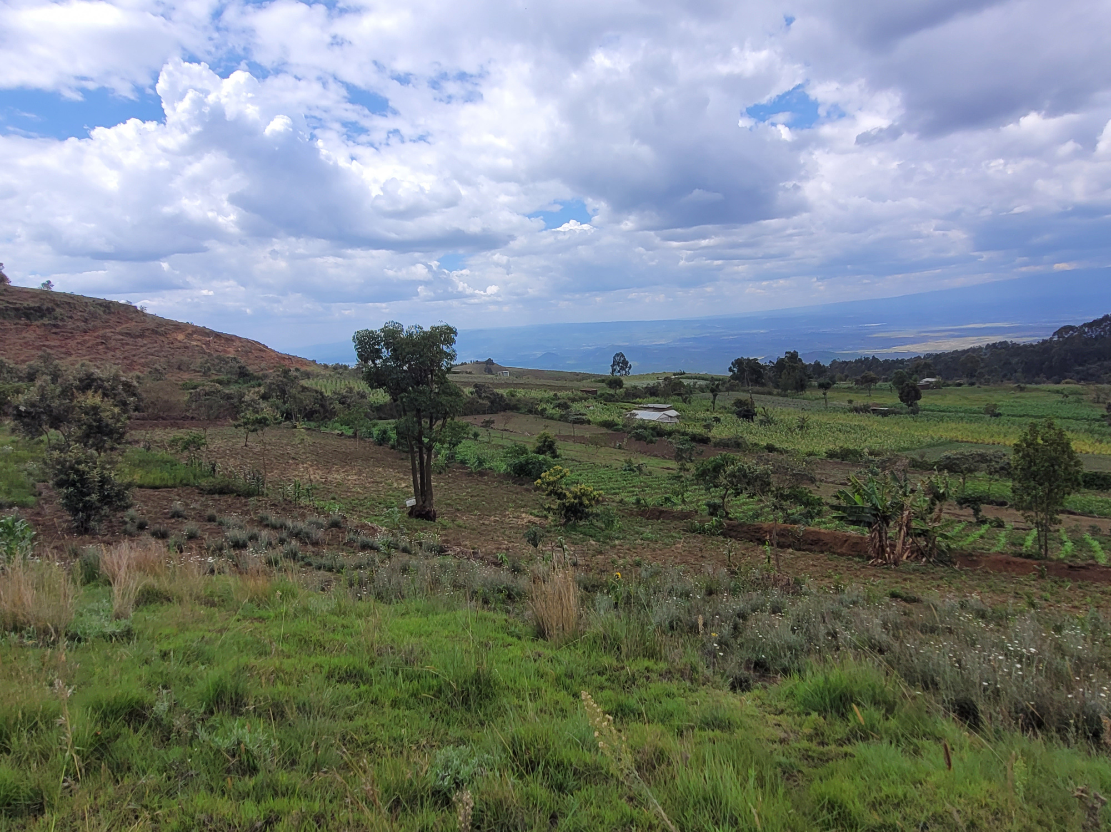
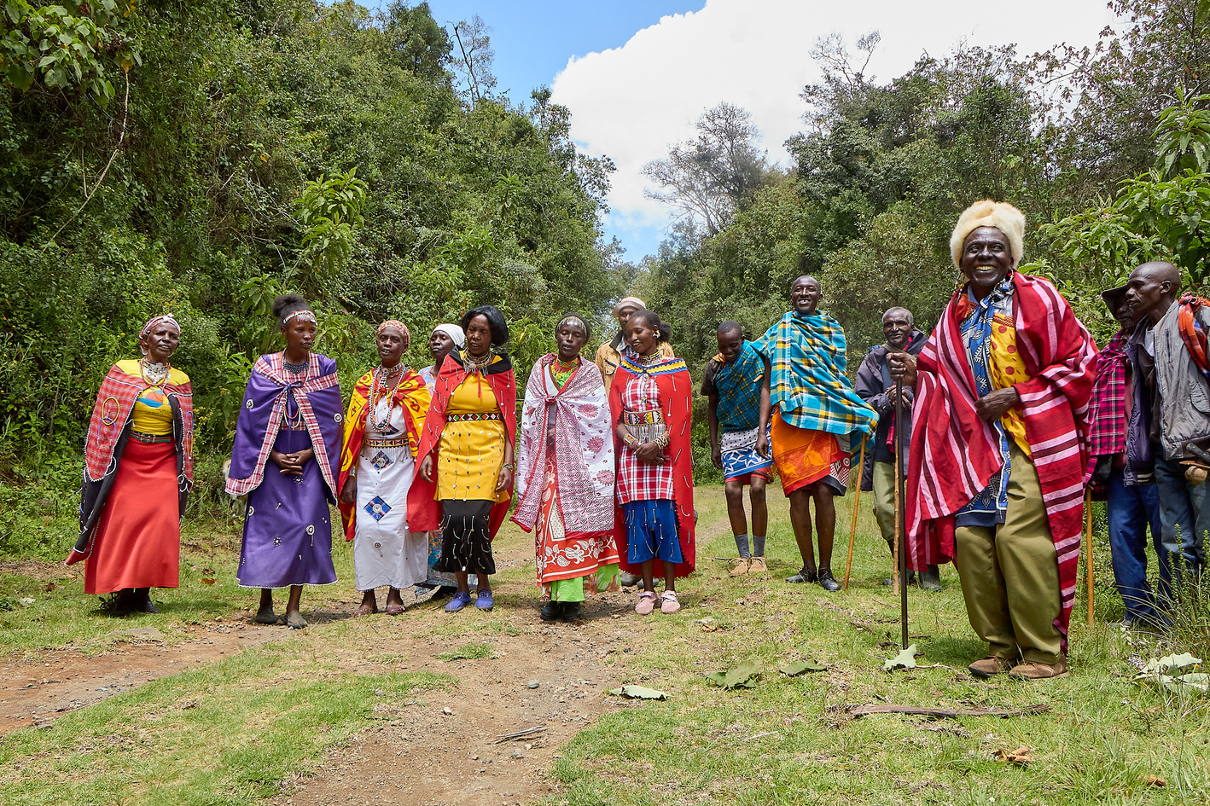

Land Degradation Hotspot &
Land Cover Land Use Change Mapping in Eburu Ecosystem

Slide 2
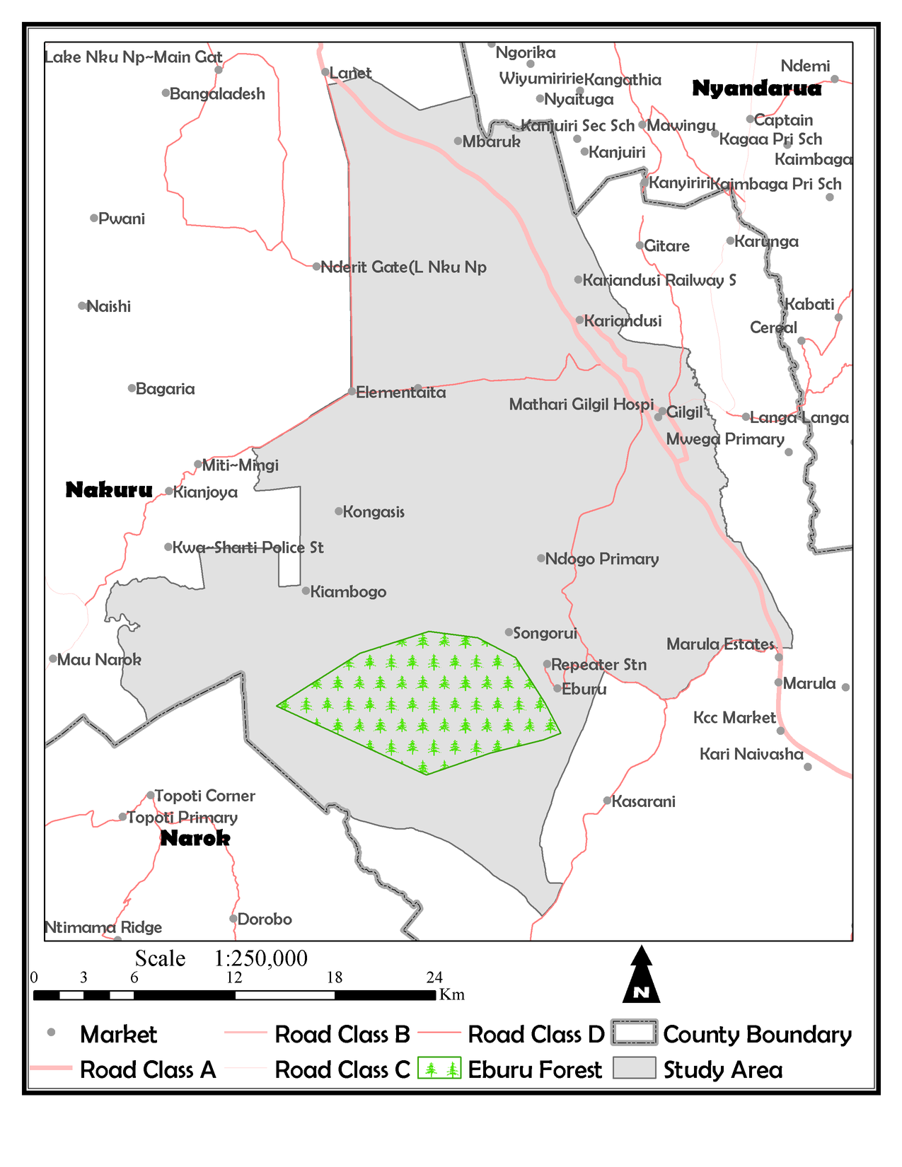
The
Study Area
The study area is located in central part of Nakuru County and extents from longitude 36.023795o to 36.394130o and Latitude -0.314437o to -0.771384o and is generally called the Eburu Ecosystem.
Administratively, it covers Gilgil, Kiambogo and Ndabibi locations and covers an area of about 971.39704 Km2 and its within it where we have the Eburu forest. The area has a population of 34, 516 Male and 32,600 females (KNBS 2020), and a population density of approximately 70 persons per square Kilometer.

Slide 3
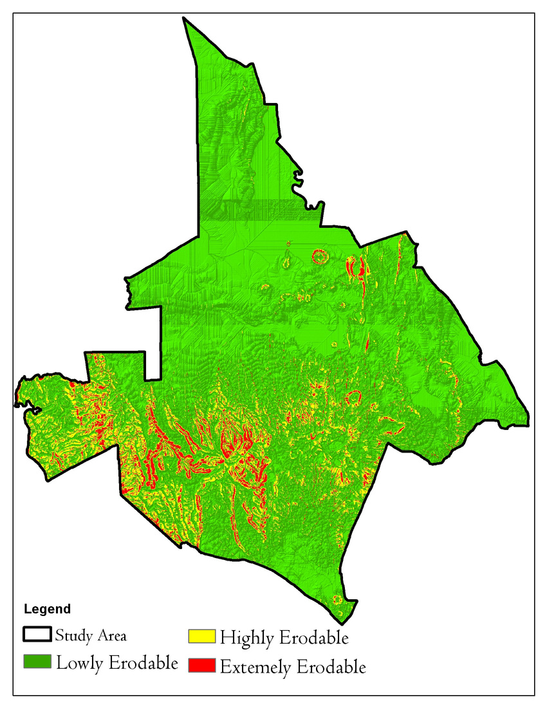
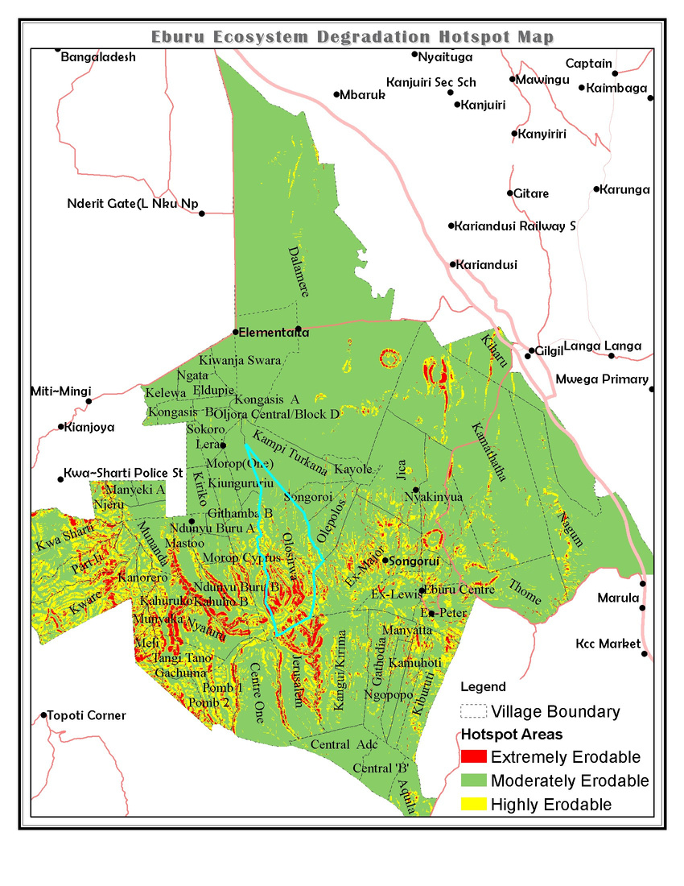
Land Degradation
The above shows land degradation areas with village data extract at villages level. Olosirwa village has the highest degradation hotspots and with extreme risk of degradation if no interventions happen.
Most of the degradation hotspots are found on the southwestern part of the study area with some patches to the southern part and the northern part.

Slide 4
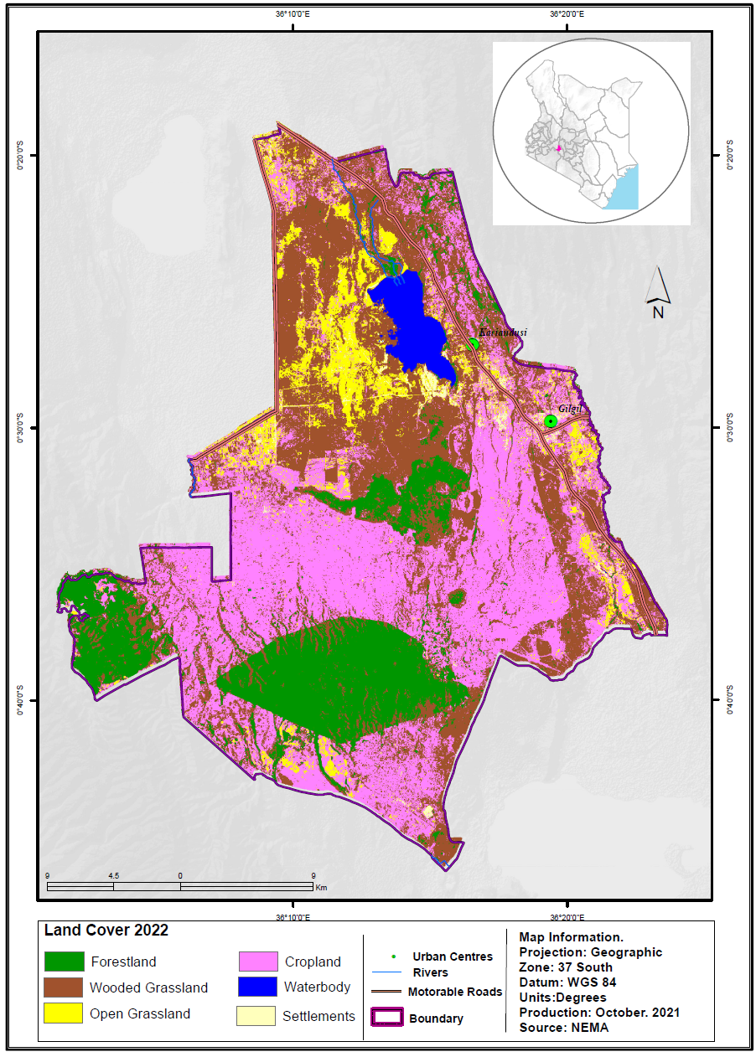
2022
Landcover Landuse Map
This map shows the classes distribution in the ecosystem in the year 2022. Cropland was the highest in hectares’ coverage, followed by wooded grasslands and the forested area.

Slide 5
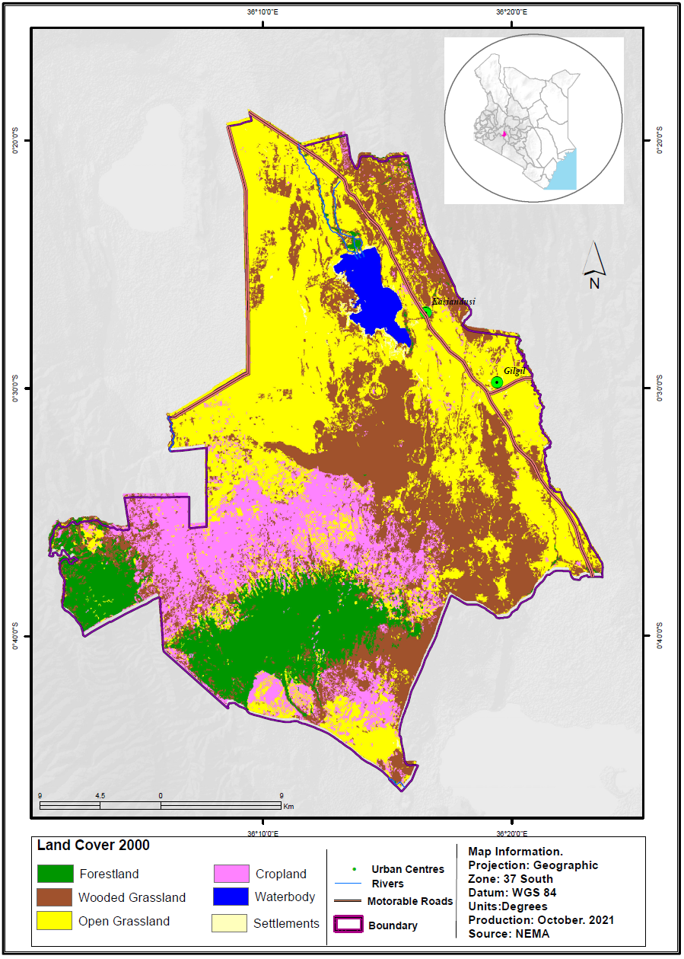
2000
Landcover Landuse Map
In the above isinuous with the Mau Forest ecosystem. The side bordering Narok County is almost undisturbed. Farmed area was not extensive as at present times. Most areas that are on farms now were wooded grasslands and open grasslands. The forest healthy was of high density in the year 2000.

Slide 6
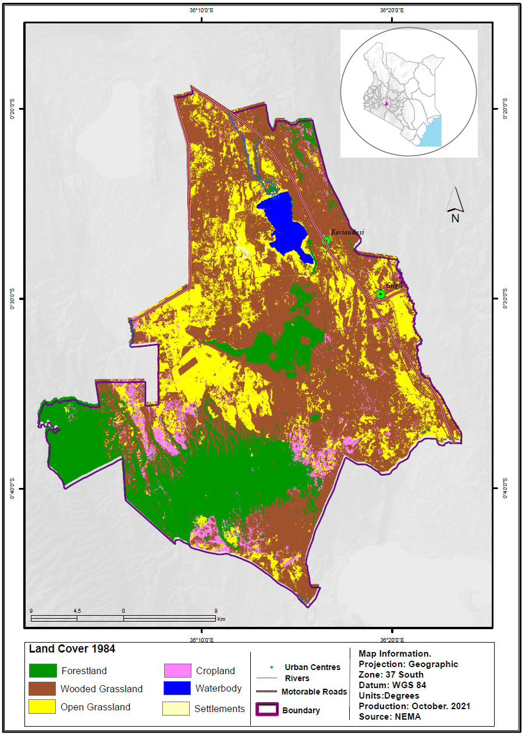
1984
Landcover Landuse Map
From the historical data and indigenous knowledge, in the year 1984, the area was not inhabited.
The population was very small and sparse. The farming activity was very minimal. The forest area not disturbed at all. The wooded grassland was also thriving in that year.

Slide 7
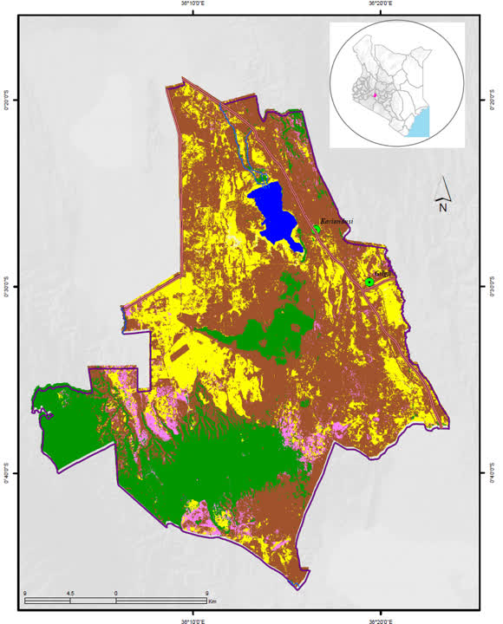
1984 - 2000 - 2022
Landcover Landuse Map

Slide 8
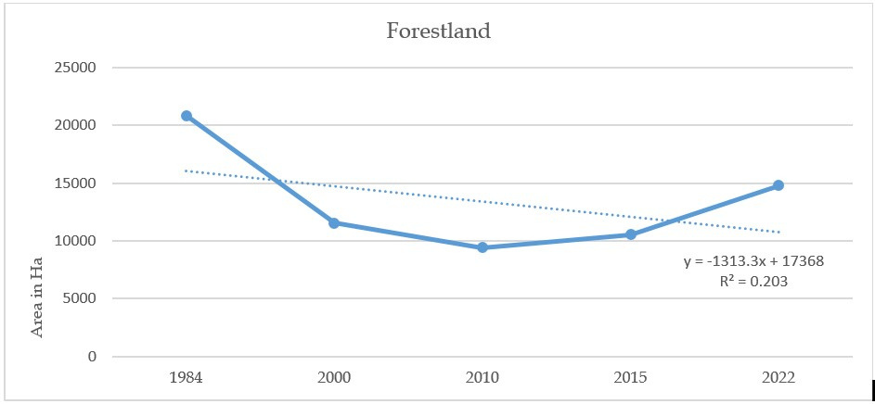
Forest Cover Trend Curve
Between 1984, 2000, 2010, 2015 & 2022
As depicted above and in the time, series maps, the forest was at its highest in 1984, dropped in 2000 all through 2010, the rise started happening in 2010, albeit slow, the forest has been regaining heath. Factors attributed to the 2010 constitution on forest cover increase to realize the 10% tree cover. Also, the positive initiatives employed by Kenya Forest in collaboration with Rhino Arc and the Mpesa Foundation.

Slide 9
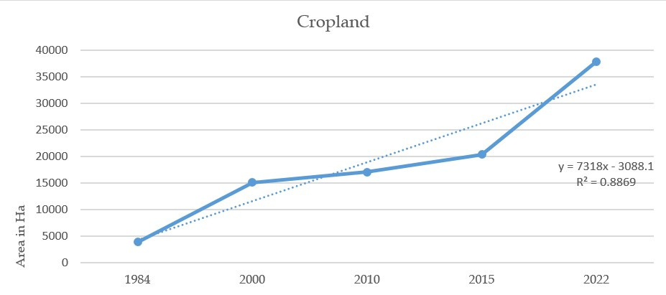
Cropland Trend Curve
Between 1984, 2000, 2010, 2015 & 2022
The reverse of the above forest trends is a true depiction of the croplands. Most of the forestland, wooded grasslands, grasslands have been cleared to give more land for subsistence farming. In the year 2022 the human activities i.e., farming has highly increased tremendously in the study area. The main one being subsistence farming of maize, potatoes, beans, wheat and pyrethrum in small scale.
This has contributed to the clearing of forests, grasslands and some woodlands to give more land for subsistence farming.

Slide 10
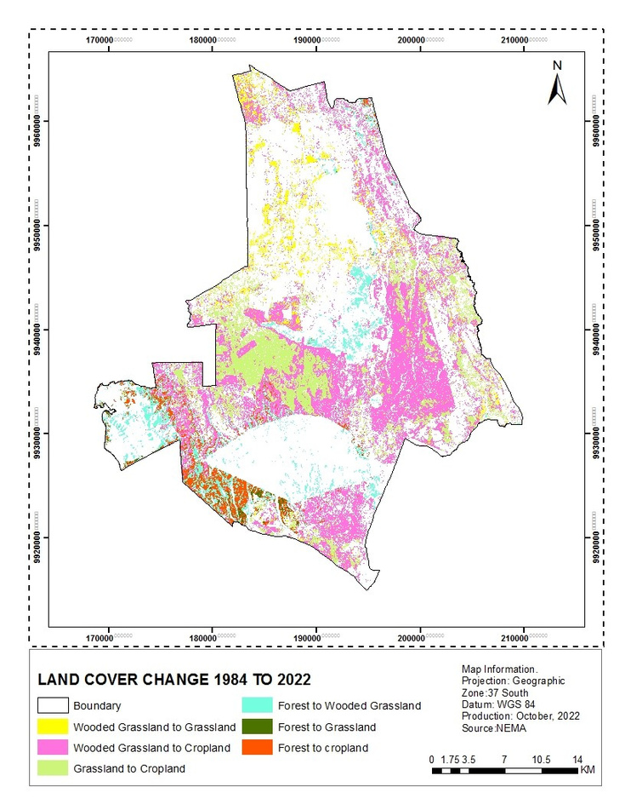
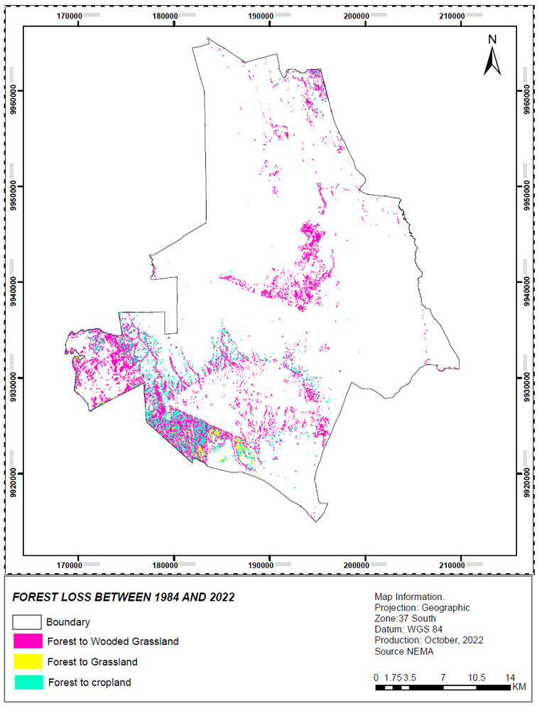
Change Maps
These maps show the losses that the Eburu ecosystem has witnessed within the years from 1984 to 2022 between the six classes. It further explains on the losses the forest cover suffered from and the class beneficiaries of the losses. The cropland was the highest gain of the forest loss.
In conclusion, the ecosystem has suffered more forest loss than gain over the study period. These could be attributed to many factors, but majorly to:
• Human disturbance through farming activities and settlement
• Climate change to some small extent.

